Slide 1
Econ 645: Week 7
Simultaneous Equation Models
*Views do not represent HRSA or HHS

Slide 2
Overview
Simultaneous Equation Models
Simultaneity Bias in OLS
Identifying and Estimating a Structural Equation
Rank and Order Conditions
Systems with More than Two Equations
Simultaneous Equations with Panel Data
Stata Section

Slide 3
Simultaneity
Simultaneity
When at least one explanatory variable in a multivariate regression is determined jointly with the dependent variable
This is a different form of endogeneity from omitted variable bias and measurement error
Simultaneous Equation Models
A model that jointly determines two or more endogenous variables, where each endogenous variable can be a function of the other endogenous variables, other exogenous variables, and an error term
Our main identification strategy
Using an instrument variable is a potential solution to simultaneity

Slide 4
Simultaneous Equation Models

Slide 5
Simultaneous Equation Models
Simultaneous Equations Models
It is a model that jointly determines two or more endogenous variables, where each endogenous variable can be a function of the other endogenous variables, other exogenous variables, and an error term
The most classic example of simultaneous equation models is a supply and demand equation for some good or service or input to production (KLEMS)
Ceteris Paribus
Each equation should have a ceteris paribus or causal interpretation
A change will have a causal interpretation from economic theory
If price increases, then quantity demanded will decrease
If price increases, then quantity supplied will increase
However, we have a problem with simultaneity bias preventing a causal interpretation when implemented using econometrics

Slide 6
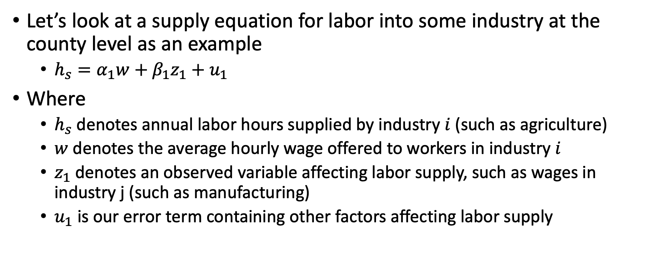
Simultaneous Equation Models
Let’s look at a supply equation for labor into some industry at the county level as an example
$h_{s}=α_{1}w+β_{1}z_{1}+u_{1}$
Where
$h_{s}$ denotes annual labor hours supplied by industry $i$ (such as agriculture)
$w$ denotes the average hourly wage offered to workers in industry $i$
$z_{1}$ denotes an observed variable affecting labor supply, such as wages in industry j (such as manufacturing)
$u_{1}$ is our error term containing other factors affecting labor supply

Slide 7
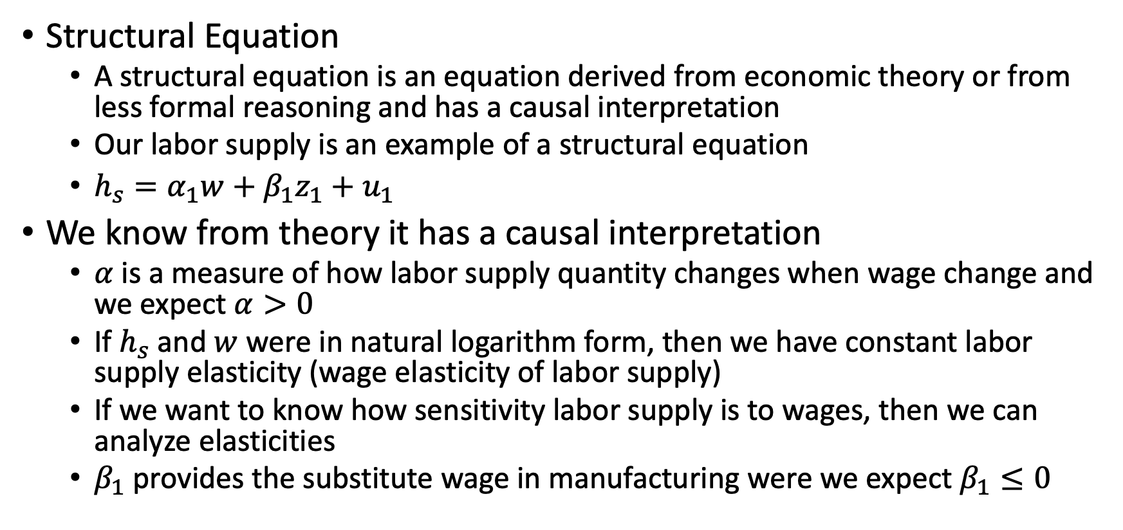
Simultaneous Equation Models
Structural Equation
A structural equation is an equation derived from economic theory or from less formal reasoning and has a causal interpretation
Our labor supply is an example of a structural equation
$h_{s}=α_{1}w+β_{1}z_{1}+u_{1}$
We know from theory it has a causal interpretation
$α$ is a measure of how labor supply quantity changes when wage change and we expect $α>0$
If $h_{s}$ and $w$ were in natural logarithm form, then we have constant labor supply elasticity (wage elasticity of labor supply)
If we want to know how sensitivity labor supply is to wages, then we can analyze elasticities
$β_{1}$ provides the substitute wage in manufacturing were we expect $β_{1}≤0$

Slide 8
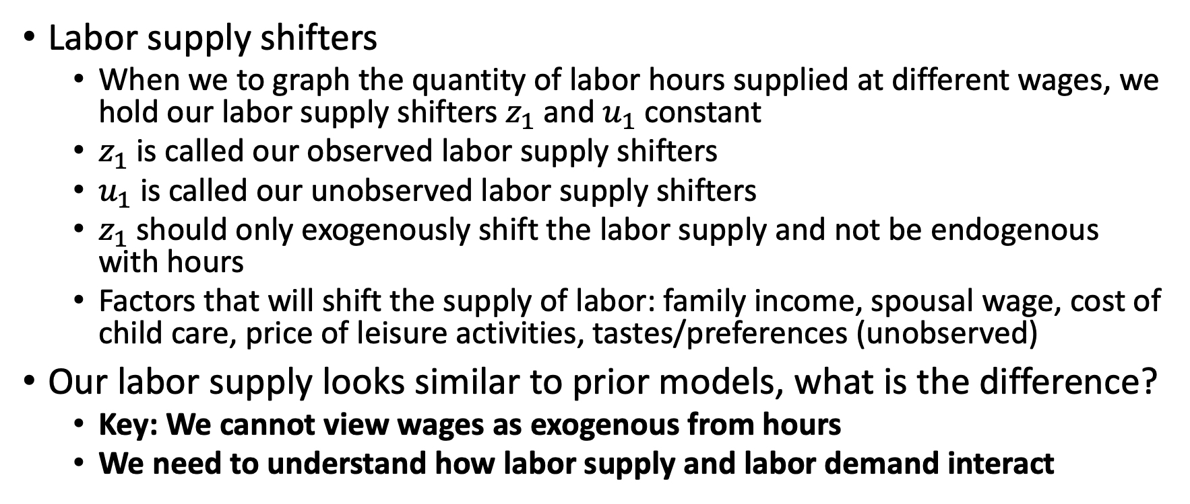
Simultaneous Equation Models
Labor supply shifters
When we to graph the quantity of labor hours supplied at different wages, we hold our labor supply shifters $z_{1}$ and $u_{1}$ constant
$z_{1}$ is called our observed labor supply shifters
$u_{1}$ is called our unobserved labor supply shifters
$z_{1}$ should only exogenously shift the labor supply and not be endogenous with hours
Factors that will shift the supply of labor: family income, spousal wage, cost of child care, price of leisure activities, tastes/preferences (unobserved)
Our labor supply looks similar to prior models, what is the difference?
Key: We cannot view wages as exogenous from hours
We need to understand how labor supply and labor demand interact

Slide 9
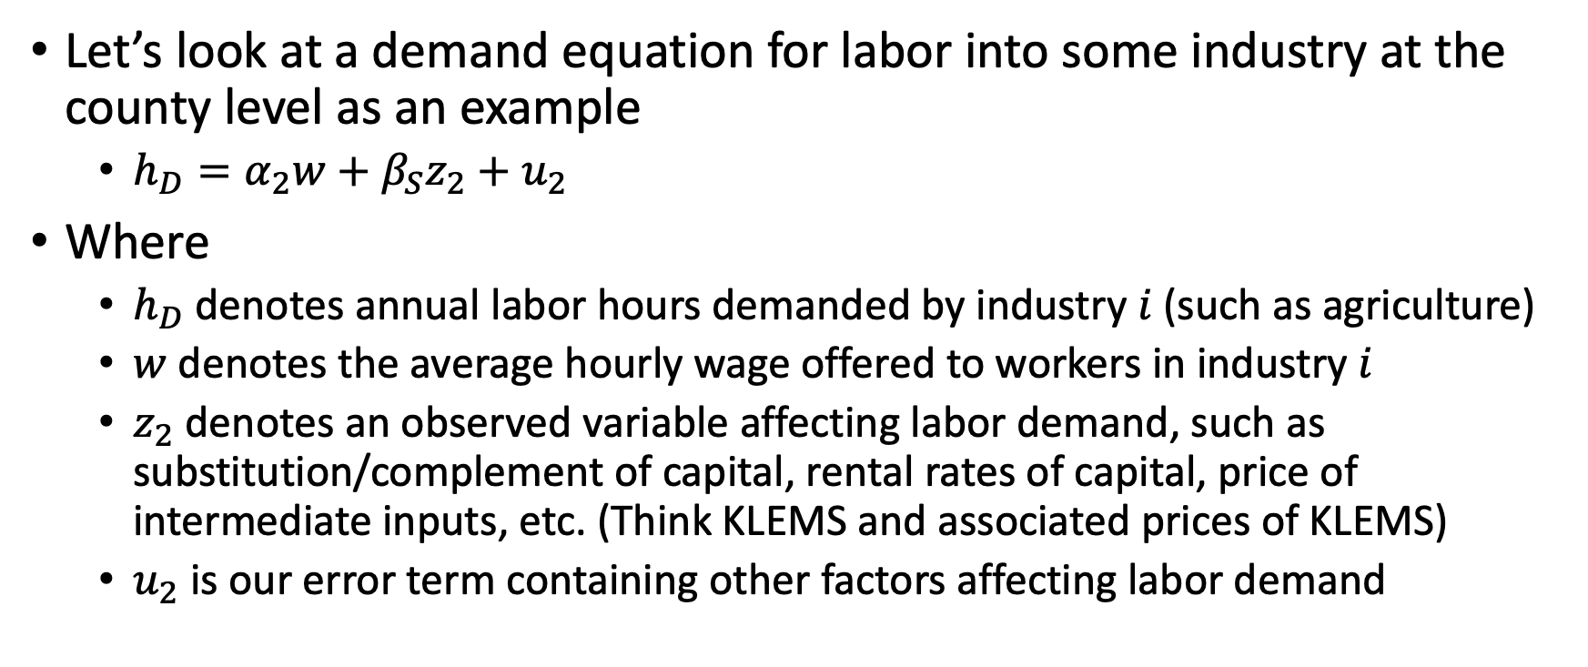
Simultaneous Equation Models
Let’s look at a demand equation for labor into some industry at the county level as an example
$h_{D}=α_{2}w+β_{S}z_{2}+u_{2}$
Where
$h_{D}$ denotes annual labor hours demanded by industry $i$ (such as agriculture)
$w$ denotes the average hourly wage offered to workers in industry $i$
$z_{2}$ denotes an observed variable affecting labor demand, such as substitution/complement of capital, rental rates of capital, price of intermediate inputs, etc. (Think KLEMS and associated prices of KLEMS)
$u_{2}$ is our error term containing other factors affecting labor demand

Slide 10
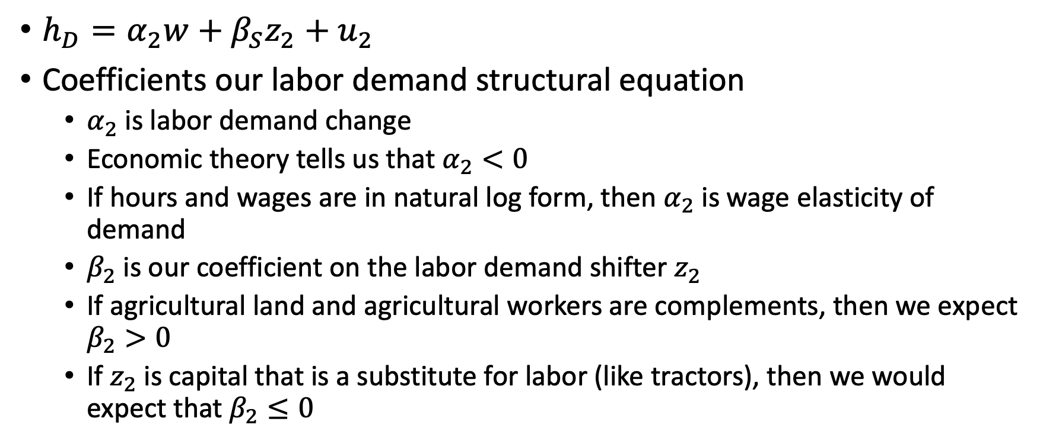
Simultaneous Equation Models
$h_{D}=α_{2}w+β_{S}z_{2}+u_{2}$
Coefficients our labor demand structural equation
$α_{2}$ is labor demand change
Economic theory tells us that $α_{2}<0$
If hours and wages are in natural log form, then $α_{2}$ is wage elasticity of demand
$β_{2}$ is our coefficient on the labor demand shifter $z_{2}$
If agricultural land and agricultural workers are complements, then we expect $β_{2}>0$
If $z_{2}$ is capital that is a substitute for labor (like tractors), then we would expect that $β_{2}≤0$

Slide 11
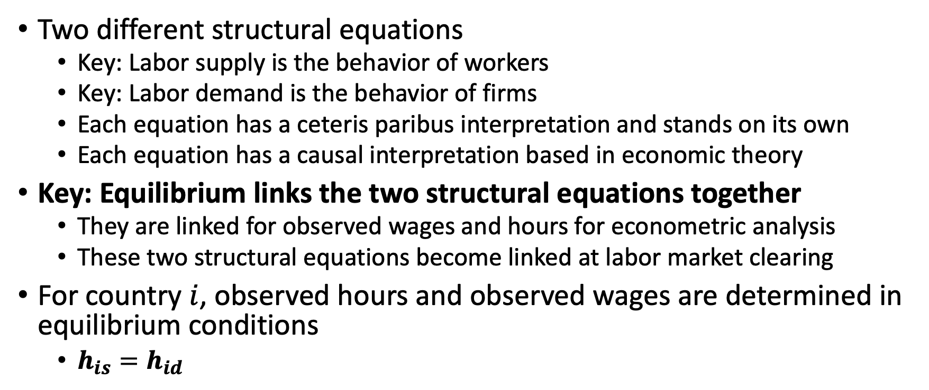
Simultaneous Equation Models
Two different structural equations
Key: Labor supply is the behavior of workers
Key: Labor demand is the behavior of firms
Each equation has a ceteris paribus interpretation and stands on its own
Each equation has a causal interpretation based in economic theory
Key: Equilibrium links the two structural equations together
They are linked for observed wages and hours for econometric analysis
These two structural equations become linked at labor market clearing
For country $i$, observed hours and observed wages are determined in equilibrium conditions
$h_{is}=h_{id}$

Slide 12
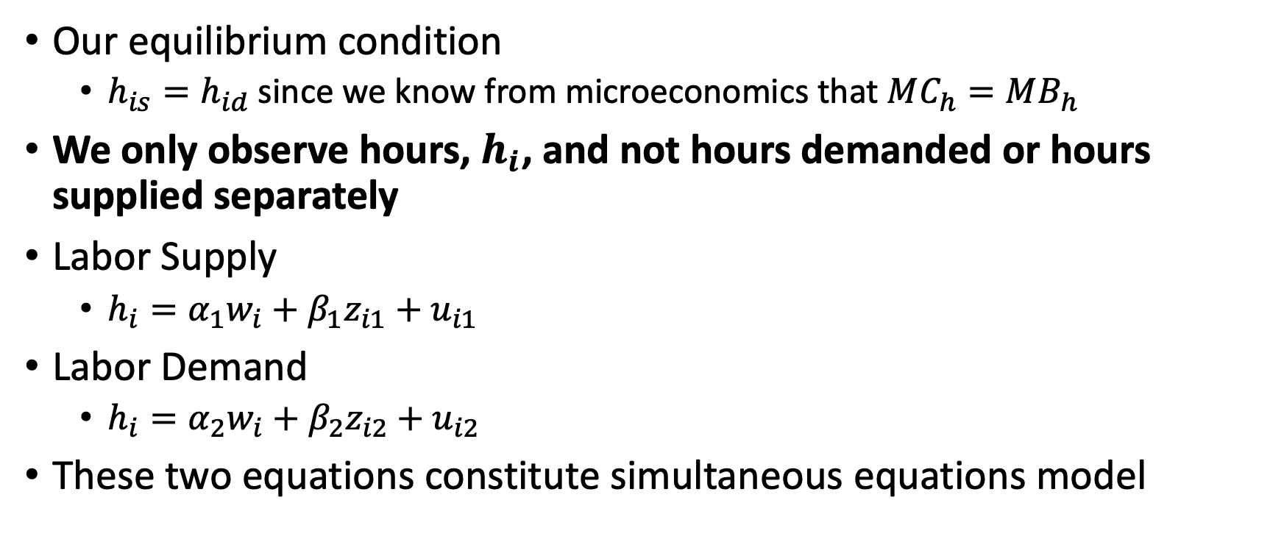
Simultaneous Equation Models
Our equilibrium condition
$h_{is}=h_{id}$ since we know from microeconomics that $MC_{h}=MB_{h}$
We only observe hours, $h_{i}$, and not hours demanded or hours supplied separately
Labor Supply
$h_{i}=α_{1}w_{i}+β_{1}z_{i1}+u_{i1}$
Labor Demand
$h_{i}=α_{2}w_{i}+β_{2}z_{i2}+u_{i2}$
These two equations constitute simultaneous equations model

Slide 13
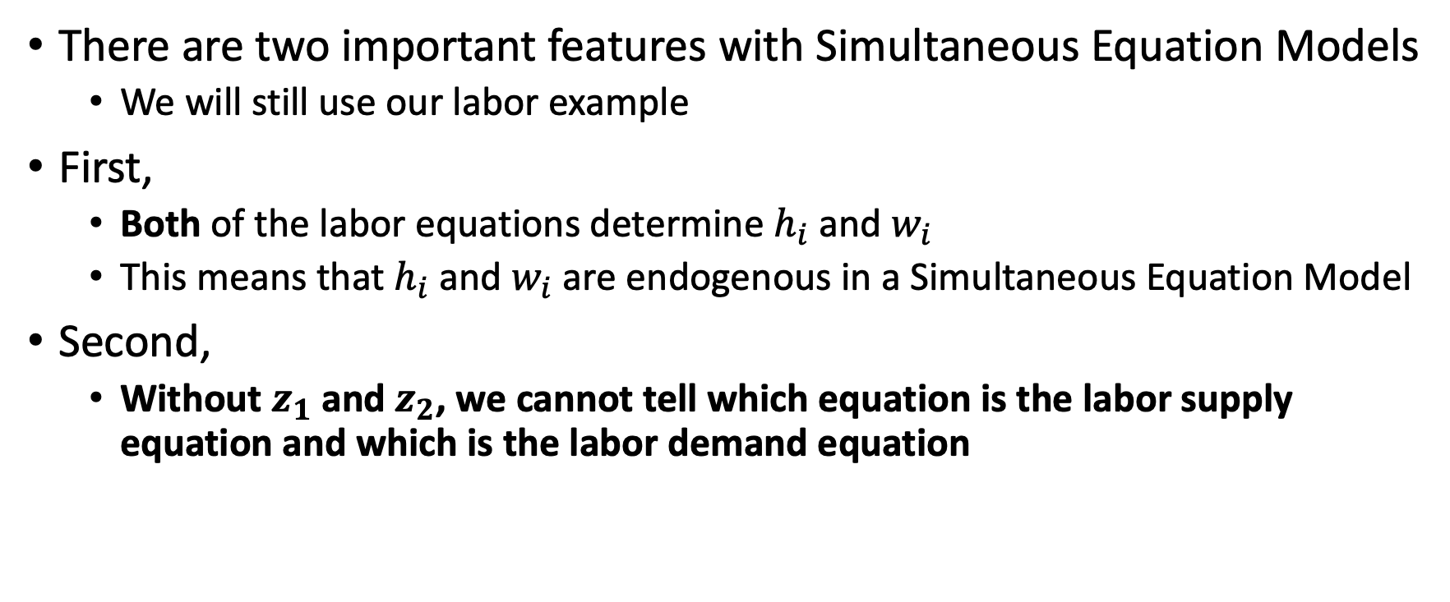
Simultaneous Equation Models
There are two important features with Simultaneous Equation Models
We will still use our labor example
First,
Both of the labor equations determine $h_{i}$ and $w_{i}$
This means that $h_{i}$ and $w_{i}$ are endogenous in a Simultaneous Equation Model
Second,
Without $z_{1}$ and $z_{2}$, we cannot tell which equation is the labor supply equation and which is the labor demand equation

Slide 14
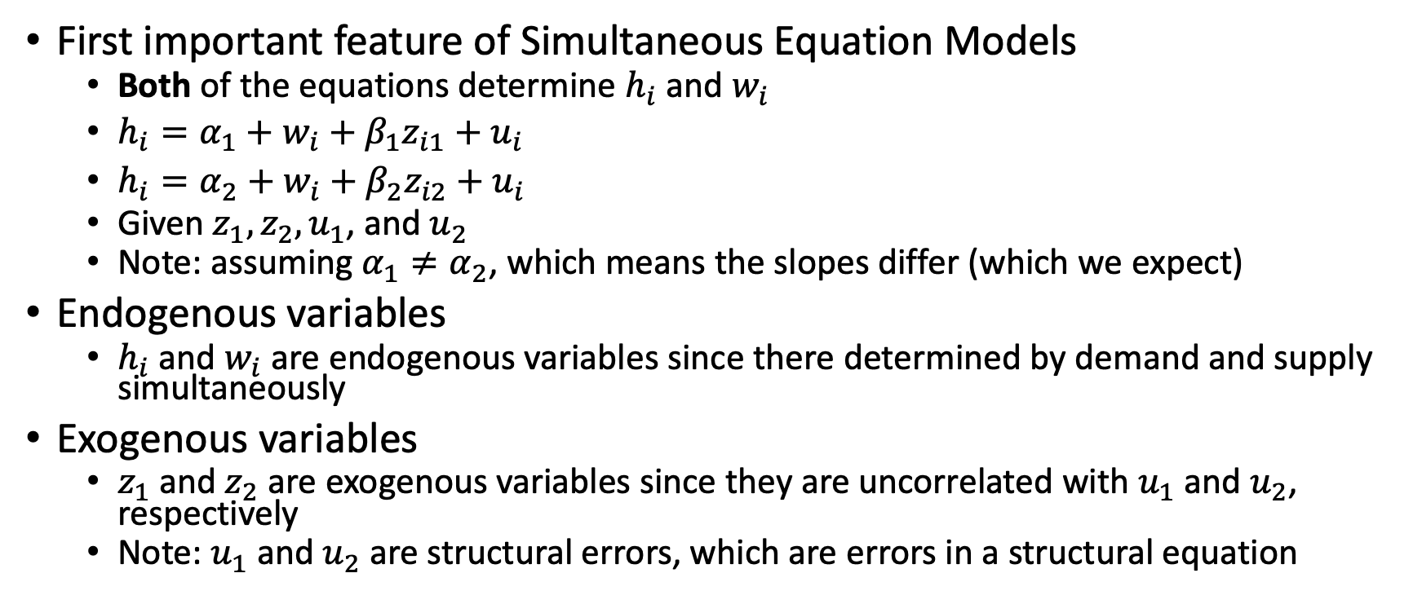
Simultaneous Equation Models
First important feature of Simultaneous Equation Models
Both of the equations determine $h_{i}$ and $w_{i}$
$h_{i}=α_{1}+w_{i}+β_{1}z_{i1}+u_{i}$
$h_{i}=α_{2}+w_{i}+β_{2}z_{i2}+u_{i}$
Given $z_{1}, z_{2}, u_{1}$, and $u_{2}$
Note: assuming $α_{1}≠α_{2}$, which means the slopes differ (which we expect)
Endogenous variables
$h_{i}$ and $w_{i}$ are endogenous variables since there determined by demand and supply simultaneously
Exogenous variables
$z_{1}$ and $z_{2}$ are exogenous variables since they are uncorrelated with $u_{1}$ and $u_{2}$, respectively
Note: $u_{1}$ and $u_{2}$ are structural errors, which are errors in a structural equation

Slide 15
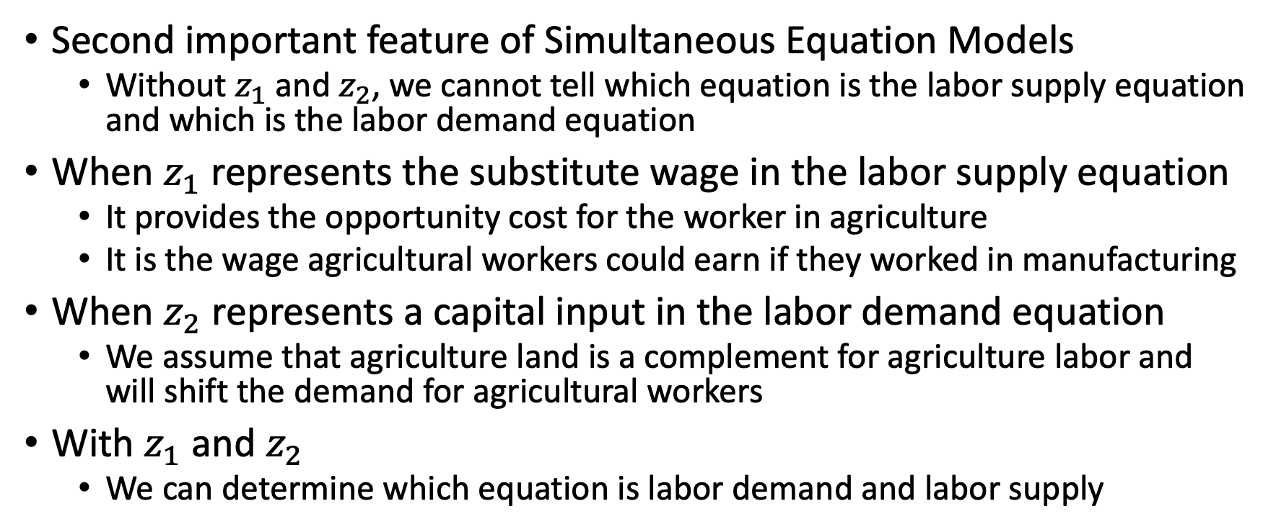
Simultaneous Equation Models
Second important feature of Simultaneous Equation Models
Without $z_{1}$ and $z_{2}$, we cannot tell which equation is the labor supply equation and which is the labor demand equation
When $z_{1}$ represents the substitute wage in the labor supply equation
It provides the opportunity cost for the worker in agriculture
It is the wage agricultural workers could earn if they worked in manufacturing
When $z_{2}$ represents a capital input in the labor demand equation
We assume that agriculture land is a complement for agriculture labor and will shift the demand for agricultural workers
With $z_{1}$ and $z_{2}$
We can determine which equation is labor demand and labor supply

Slide 16
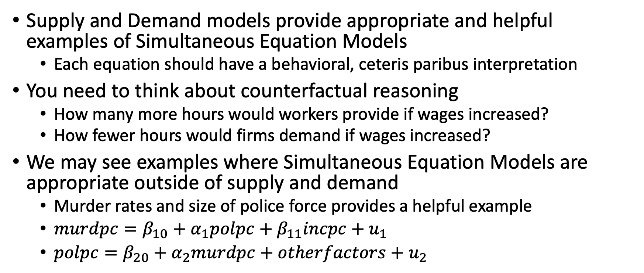
Simultaneous Equation Models
Supply and Demand models provide appropriate and helpful examples of Simultaneous Equation Models
Each equation should have a behavioral, ceteris paribus interpretation
You need to think about counterfactual reasoning
How many more hours would workers provide if wages increased?
How fewer hours would firms demand if wages increased?
We may see examples where Simultaneous Equation Models are appropriate outside of supply and demand
Murder rates and size of police force provides a helpful example
$murdpc=β_{10}+α_{1}polpc+β_{11}incpc+u_{1}$
$polpc=β_{20}+α_{2}murdpc+otherfactors+u_{2}$

Slide 17
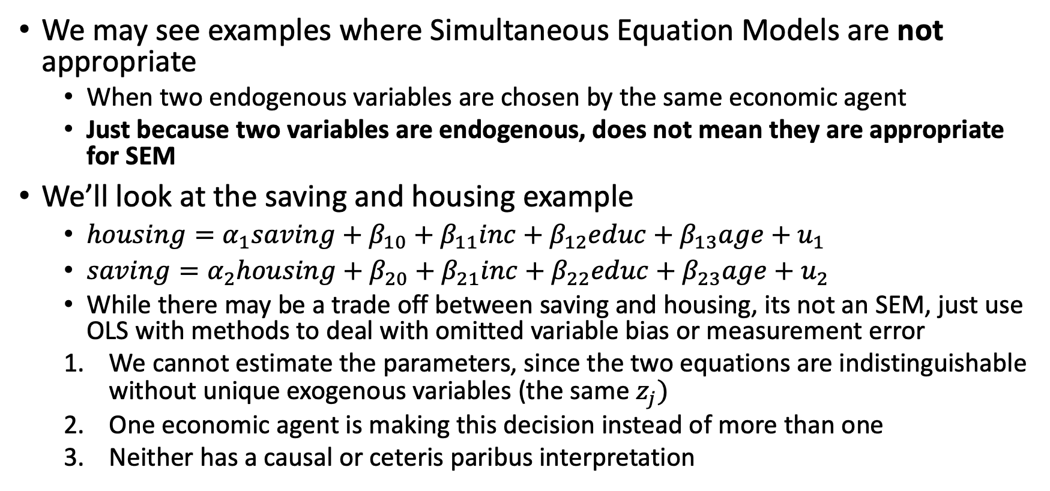
Simultaneous Equation Models
We may see examples where Simultaneous Equation Models are not appropriate
When two endogenous variables are chosen by the same economic agent
Just because two variables are endogenous, does not mean they are appropriate for SEM
We’ll look at the saving and housing example
$housing=α_{1}saving+β_{10}+β_{11}inc+β_{12}educ+β_{13}age+u_{1}$
$saving=α_{2}housing+β_{20}+β_{21}inc+β_{22}educ+β_{23}age+u_{2}$
While there may be a trade off between saving and housing, its not an SEM, just use OLS with methods to deal with omitted variable bias or measurement error
We cannot estimate the parameters, since the two equations are indistinguishable without unique exogenous variables (the same $z_{j})$
One economic agent is making this decision instead of more than one
Neither has a causal or ceteris paribus interpretation

Slide 18
Simultaneity Bias in OLS

Slide 19
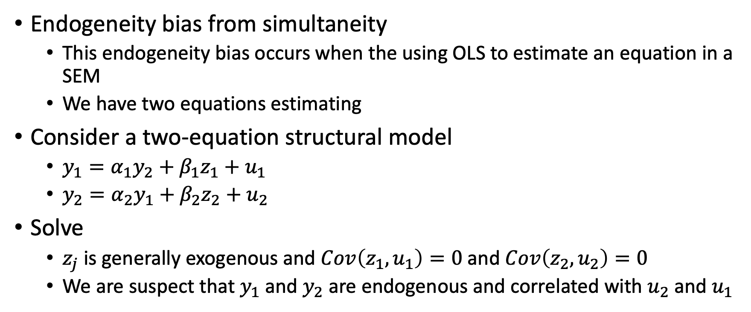
Simultaneity Bias in OLS
Endogeneity bias from simultaneity
This endogeneity bias occurs when the using OLS to estimate an equation in a SEM
We have two equations estimating
Consider a two-equation structural model
$y_{1}=α_{1}y_{2}+β_{1}z_{1}+u_{1}$
$y_{2}=α_{2}y_{1}+β_{2}z_{2}+u_{2}$
Solve
$z_{j}$ is generally exogenous and $Cov\left(z_{1},u_{1}\right)=0$ and $Cov\left(z_{2},u_{2}\right)=0$
We are suspect that $y_{1}$ and $y_{2}$ are endogenous and correlated with $u_{2}$ and $u_{1}$

Slide 20
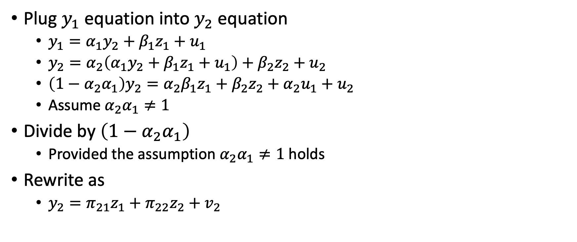
Simultaneity Bias in OLS
Plug $y_{1}$ equation into $y_{2}$ equation
$y_{1}=α_{1}y_{2}+β_{1}z_{1}+u_{1}$
$y_{2}=α_{2}\left(α_{1}y_{2}+β_{1}z_{1}+u_{1}\right)+β_{2}z_{2}+u_{2}$
$\left(1−α_{2}α_{1}\right)y_{2}=α_{2}β_{1}z_{1}+β_{2}z_{2}+α_{2}u_{1}+u_{2}$
Assume $α_{2}α_{1}≠1$
Divide by $\left(1−α_{2}α_{1}\right)$
Provided the assumption $α_{2}α_{1}≠1$ holds
Rewrite as
$y_{2}=π_{21}z_{1}+π_{22}z_{2}+v_{2}$

Slide 21
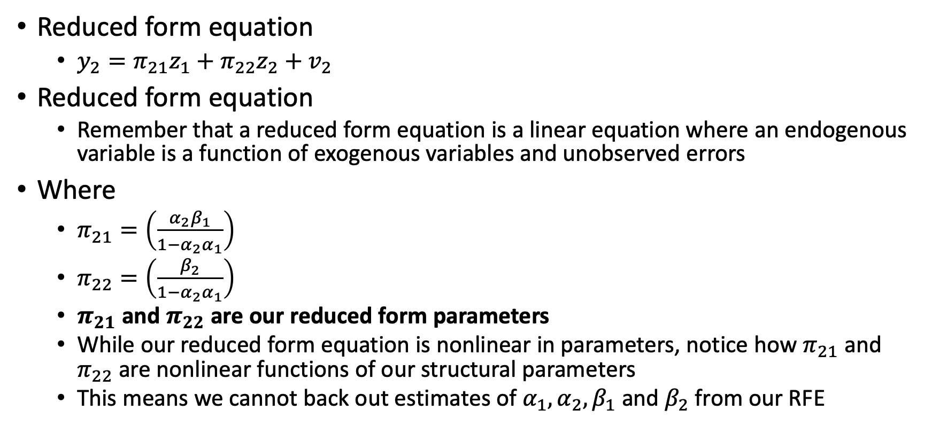
Simultaneity Bias in OLS
Reduced form equation
$y_{2}=π_{21}z_{1}+π_{22}z_{2}+v_{2}$
Reduced form equation
Remember that a reduced form equation is a linear equation where an endogenous variable is a function of exogenous variables and unobserved errors
Where
$π_{21}=\left(\frac{α_{2}β_{1}}{1−α_{2}α_{1}}\right)$
$π_{22}=\left(\frac{β_{2}}{1−α_{2}α_{1}}\right)$
$π_{21}$ and $π_{22}$ are our reduced form parameters
While our reduced form equation is nonlinear in parameters, notice how $π_{21}$ and $π_{22}$ are nonlinear functions of our structural parameters
This means we cannot back out estimates of $α_{1}, α_{2}, β_{1}$ and $β_{2}$ from our RFE

Slide 22
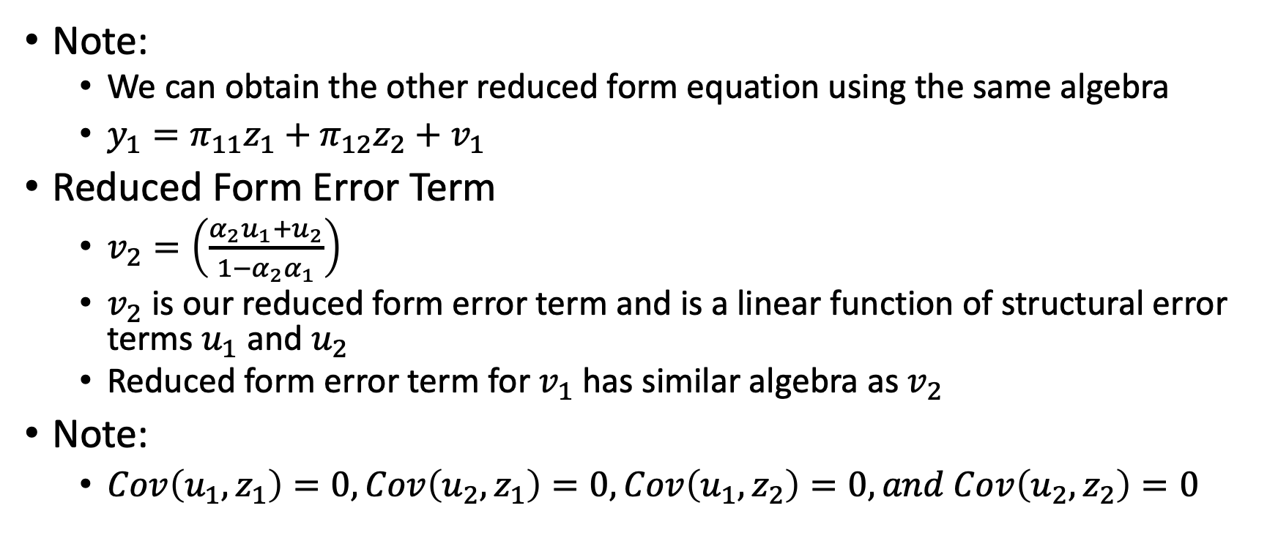
Simultaneity Bias in OLS
Note:
We can obtain the other reduced form equation using the same algebra
$y_{1}=π_{11}z_{1}+π_{12}z_{2}+v_{1}$
Reduced Form Error Term
$v_{2}=\left(\frac{α_{2}u_{1}+u_{2}}{1−α_{2}α_{1}}\right)$
$v_{2}$ is our reduced form error term and is a linear function of structural error terms $u_{1}$ and $u_{2}$
Reduced form error term for $v_{1}$ has similar algebra as $v_{2}$
Note:
$Cov\left(u_{1},z_{1}\right)=0, Cov\left(u_{2},z_{1}\right)=0, Cov\left(u_{1},z_{2}\right)=0, and Cov\left(u_{2},z_{2}\right)=0$

Slide 23
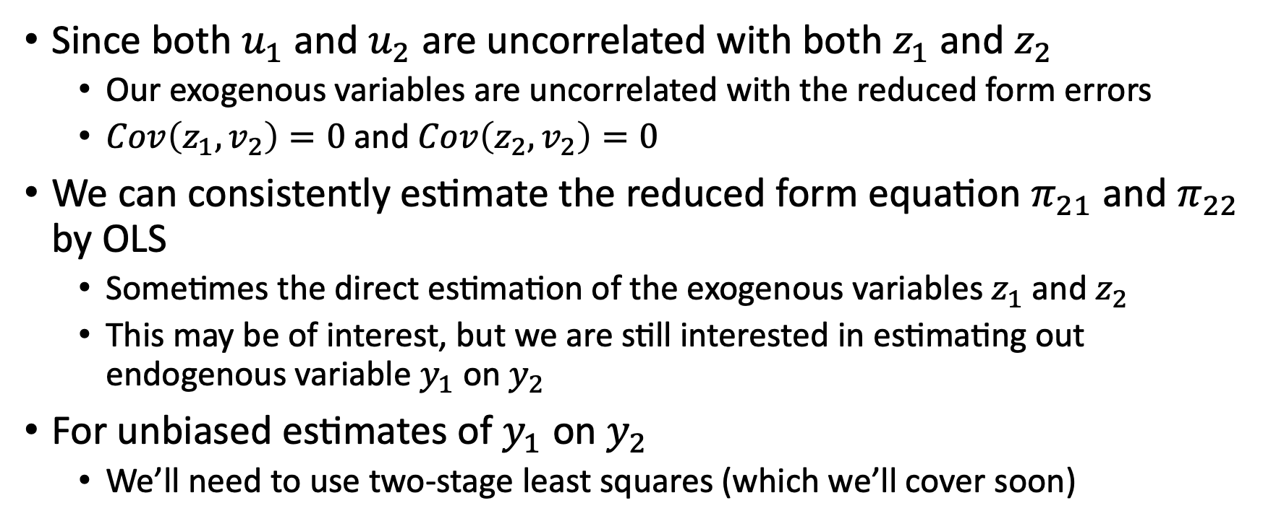
Simultaneity Bias in OLS
Since both $u_{1}$ and $u_{2}$ are uncorrelated with both $z_{1}$ and $z_{2}$
Our exogenous variables are uncorrelated with the reduced form errors
$Cov\left(z_{1},v_{2}\right)=0$ and $Cov\left(z_{2},v_{2}\right)=0$
We can consistently estimate the reduced form equation $π_{21}$ and $π_{22}$ by OLS
Sometimes the direct estimation of the exogenous variables $z_{1}$ and $z_{2}$
This may be of interest, but we are still interested in estimating out endogenous variable $y_{1}$ on $y_{2}$
For unbiased estimates of $y_{1}$ on $y_{2}$
We’ll need to use two-stage least squares (which we’ll cover soon)

Slide 24
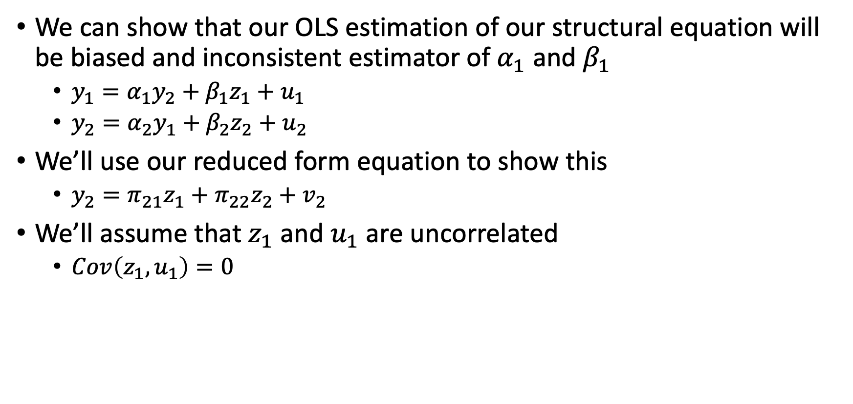
Simultaneity Bias in OLS
We can show that our OLS estimation of our structural equation will be biased and inconsistent estimator of $α_{1}$ and $β_{1}$
$y_{1}=α_{1}y_{2}+β_{1}z_{1}+u_{1}$
$y_{2}=α_{2}y_{1}+β_{2}z_{2}+u_{2}$
We’ll use our reduced form equation to show this
$y_{2}=π_{21}z_{1}+π_{22}z_{2}+v_{2}$
We’ll assume that $z_{1}$ and $u_{1}$ are uncorrelated
$Cov\left(z_{1},u_{1}\right)=0$

Slide 25
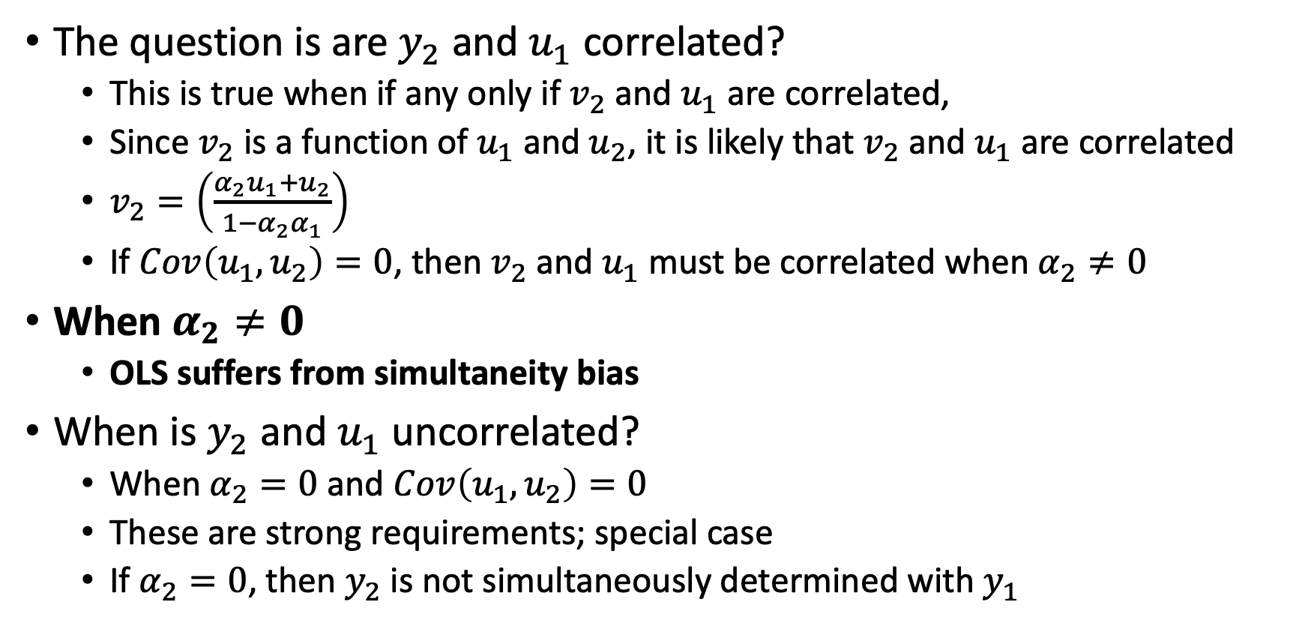
Simultaneity Bias in OLS
The question is are $y_{2}$ and $u_{1}$ correlated?
This is true when if any only if $v_{2}$ and $u_{1}$ are correlated,
Since $v_{2}$ is a function of $u_{1}$ and $u_{2}$, it is likely that $v_{2}$ and $u_{1}$ are correlated
$v_{2}=\left(\frac{α_{2}u_{1}+u_{2}}{1−α_{2}α_{1}}\right)$
If $Cov\left(u_{1},u_{2}\right)=0$, then $v_{2}$ and $u_{1}$ must be correlated when $α_{2}≠0$
When $α_{2}≠0$
OLS suffers from simultaneity bias
When is $y_{2}$ and $u_{1}$ uncorrelated?
When $α_{2}=0$ and $Cov\left(u_{1},u_{2}\right)=0$
These are strong requirements; special case
If $α_{2}=0$, then $y_{2}$ is not simultaneously determined with $y_{1}$

Slide 26
Identifying and Estimating a Structural Equation

Slide 27
Identifying and Estimating a Structural Equation
We saw that an OLS estimator will be biased and inconsistent when applied to simultaneous equation models
We can use Two-Stage Least Squares (2SLS) estimator to get unbiased and consistent estimates
2SLS solves the problem of endogenous explanatory variables
While it does solve the problem, it does increase standard errors since we lose variation in our explanatory variable of interest
Our 2SLS estimator
It will be similar to what we saw in Week 2
The difference is when applied to a simultaneous equation model, we can see whether sufficient IVs are available to estimate either structural equation

Slide 28
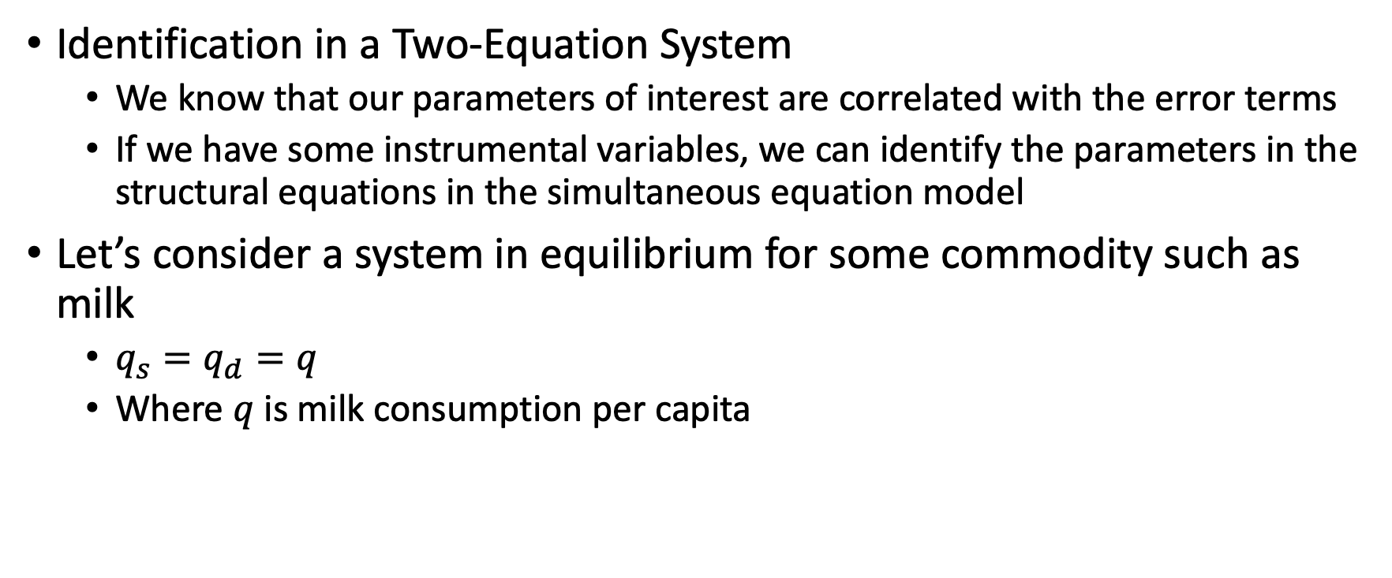
Identifying and Estimating a Structural Equation
Identification in a Two-Equation System
We know that our parameters of interest are correlated with the error terms
If we have some instrumental variables, we can identify the parameters in the structural equations in the simultaneous equation model
Let’s consider a system in equilibrium for some commodity such as milk
$q_{s}=q_{d}=q$
Where $q$ is milk consumption per capita

Slide 29
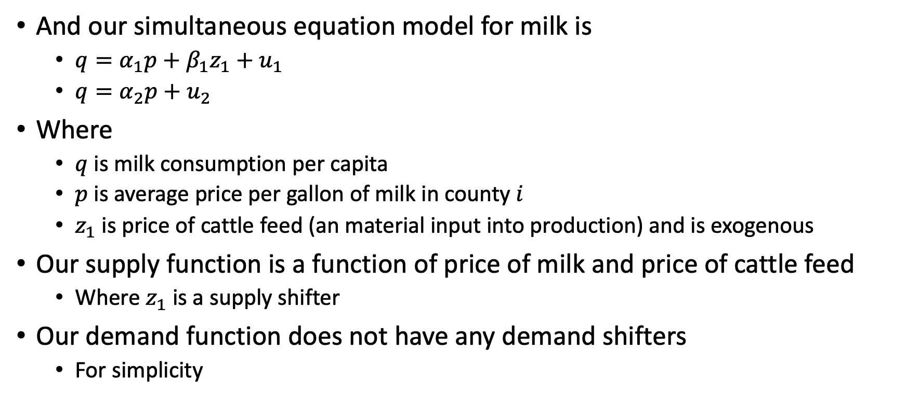
Identifying and Estimating a Structural Equation
And our simultaneous equation model for milk is
$q=α_{1}p+β_{1}z_{1}+u_{1}$
$q=α_{2}p+u_{2}$
Where
$q$ is milk consumption per capita
$p$ is average price per gallon of milk in county $i$
$z_{1}$ is price of cattle feed (an material input into production) and is exogenous
Our supply function is a function of price of milk and price of cattle feed
Where $z_{1}$ is a supply shifter
Our demand function does not have any demand shifters
For simplicity

Slide 30
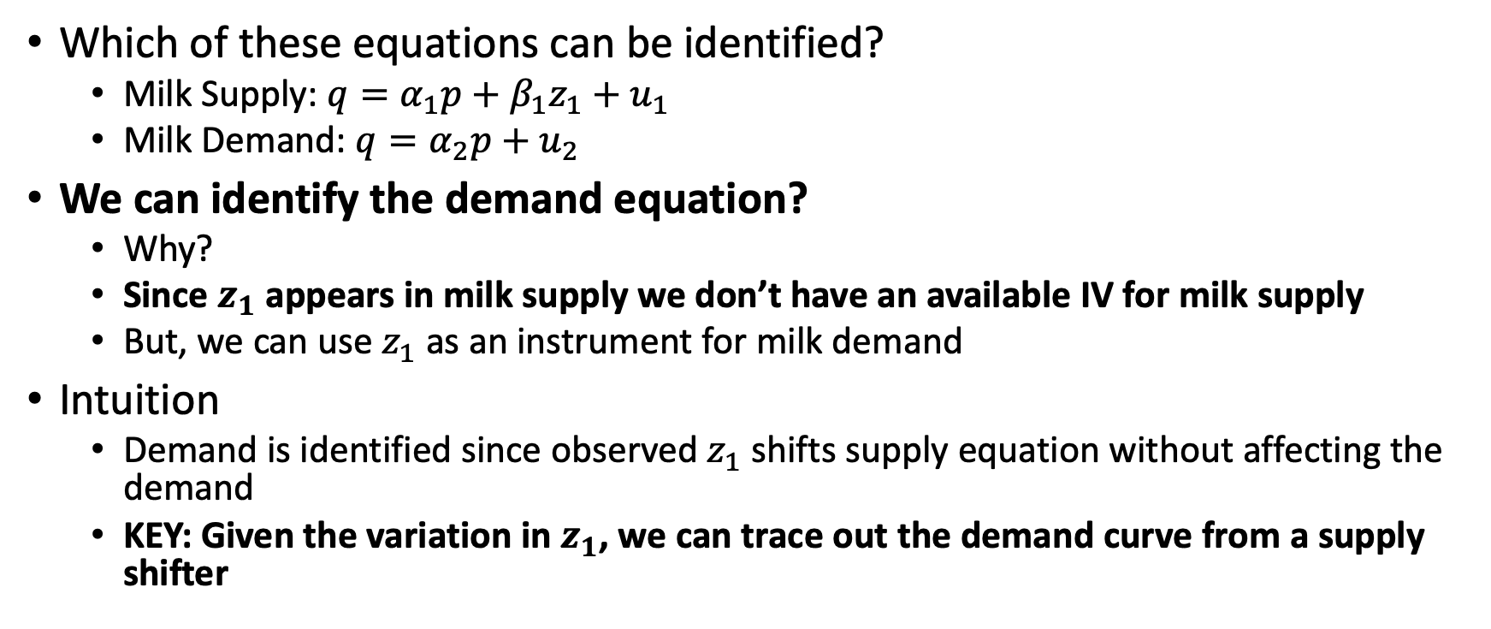
Identifying and Estimating a Structural Equation
Which of these equations can be identified?
Milk Supply: $q=α_{1}p+β_{1}z_{1}+u_{1}$
Milk Demand: $q=α_{2}p+u_{2}$
We can identify the demand equation?
Why?
Since $z_{1}$ appears in milk supply we don’t have an available IV for milk supply
But, we can use $z_{1}$ as an instrument for milk demand
Intuition
Demand is identified since observed $z_{1}$ shifts supply equation without affecting the demand
KEY: Given the variation in $z_{1}$, we can trace out the demand curve from a supply shifter

Slide 31
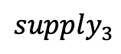
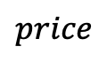
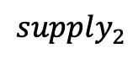
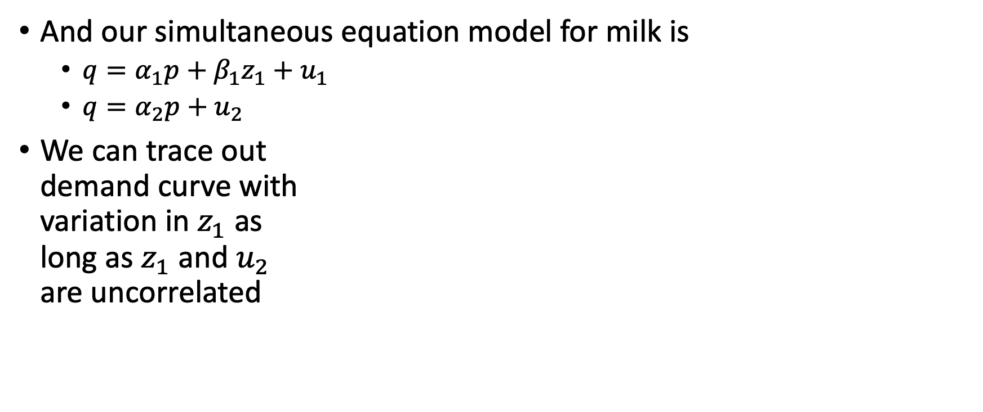
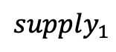
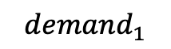
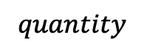
Identifying and Estimating a Structural Equation
And our simultaneous equation model for milk is
$q=α_{1}p+β_{1}z_{1}+u_{1}$
$q=α_{2}p+u_{2}$
We can trace out demand curve with variation in $z_{1}$ as long as $z_{1}$ and $u_{2}$ are uncorrelated
$$price$$
$$supply_{1}$$
$$supply_{2}$$
$$supply_{3}$$
$$demand_{1}$$
$$quantity$$

Slide 32
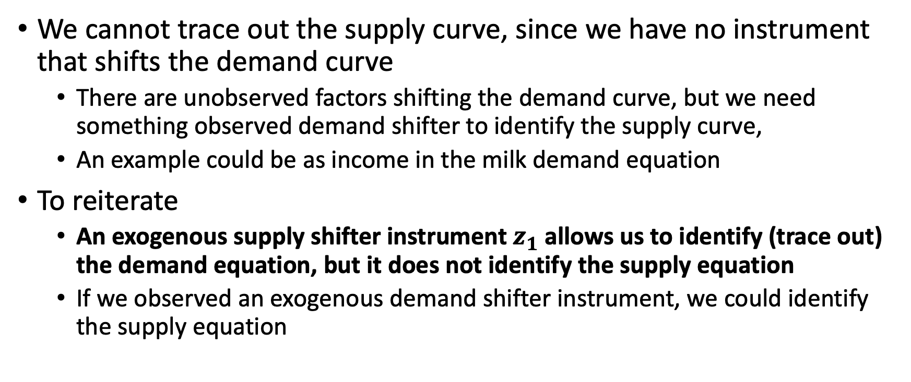
Identifying and Estimating a Structural Equation
We cannot trace out the supply curve, since we have no instrument that shifts the demand curve
There are unobserved factors shifting the demand curve, but we need something observed demand shifter to identify the supply curve,
An example could be as income in the milk demand equation
To reiterate
An exogenous supply shifter instrument $z_{1}$ allows us to identify (trace out) the demand equation, but it does not identify the supply equation
If we observed an exogenous demand shifter instrument, we could identify the supply equation

Slide 33
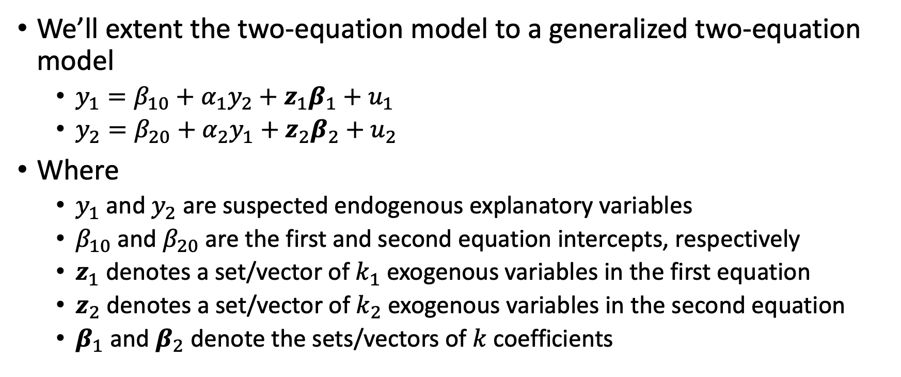
Identifying and Estimating a Structural Equation
We’ll extent the two-equation model to a generalized two-equation model
$y_{1}=β_{10}+α_{1}y_{2}+z_{1}β_{1}+u_{1}$
$y_{2}=β_{20}+α_{2}y_{1}+z_{2}β_{2}+u_{2}$
Where
$y_{1}$ and $y_{2}$ are suspected endogenous explanatory variables
$β_{10}$ and $β_{20}$ are the first and second equation intercepts, respectively
$z_{1}$ denotes a set/vector of $k_{1}$ exogenous variables in the first equation
$z_{2}$ denotes a set/vector of $k_{2}$ exogenous variables in the second equation
$β_{1}$ and $β_{2}$ denote the sets/vectors of $k$ coefficients

Slide 34
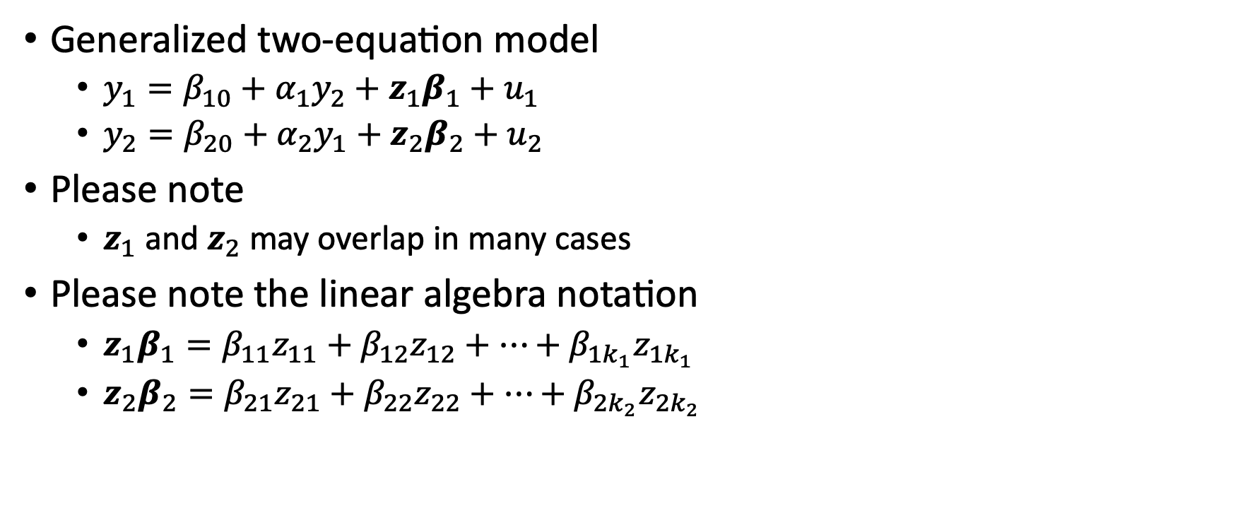
Identifying and Estimating a Structural Equation
Generalized two-equation model
$y_{1}=β_{10}+α_{1}y_{2}+z_{1}β_{1}+u_{1}$
$y_{2}=β_{20}+α_{2}y_{1}+z_{2}β_{2}+u_{2}$
Please note
$z_{1}$ and $z_{2}$ may overlap in many cases
Please note the linear algebra notation
$z_{1}β_{1}=β_{11}z_{11}+β_{12}z_{12}+…+β_{1k_{1}}z_{1k_{1}}$
$z_{2}β_{2}=β_{21}z_{21}+β_{22}z_{22}+…+β_{2k_{2}}z_{2k_{2}}$

Slide 35
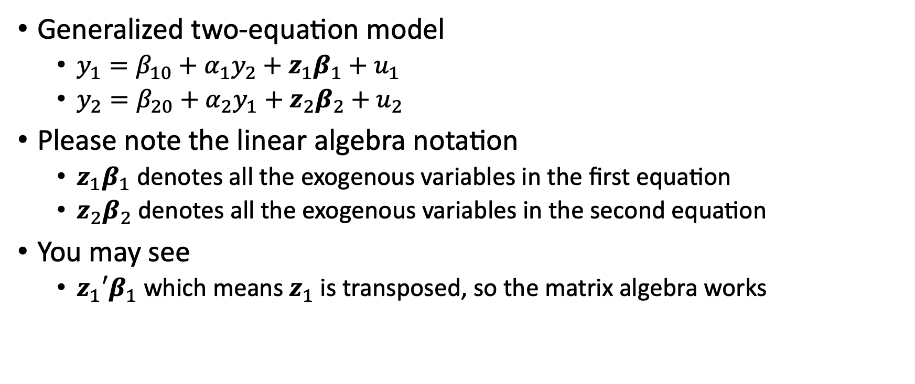
Identifying and Estimating a Structural Equation
Generalized two-equation model
$y_{1}=β_{10}+α_{1}y_{2}+z_{1}β_{1}+u_{1}$
$y_{2}=β_{20}+α_{2}y_{1}+z_{2}β_{2}+u_{2}$
Please note the linear algebra notation
$z_{1}β_{1}$ denotes all the exogenous variables in the first equation
$z_{2}β_{2}$ denotes all the exogenous variables in the second equation
You may see
$z_{1}′β_{1}$ which means $z_{1}$ is transposed, so the matrix algebra works

Slide 36
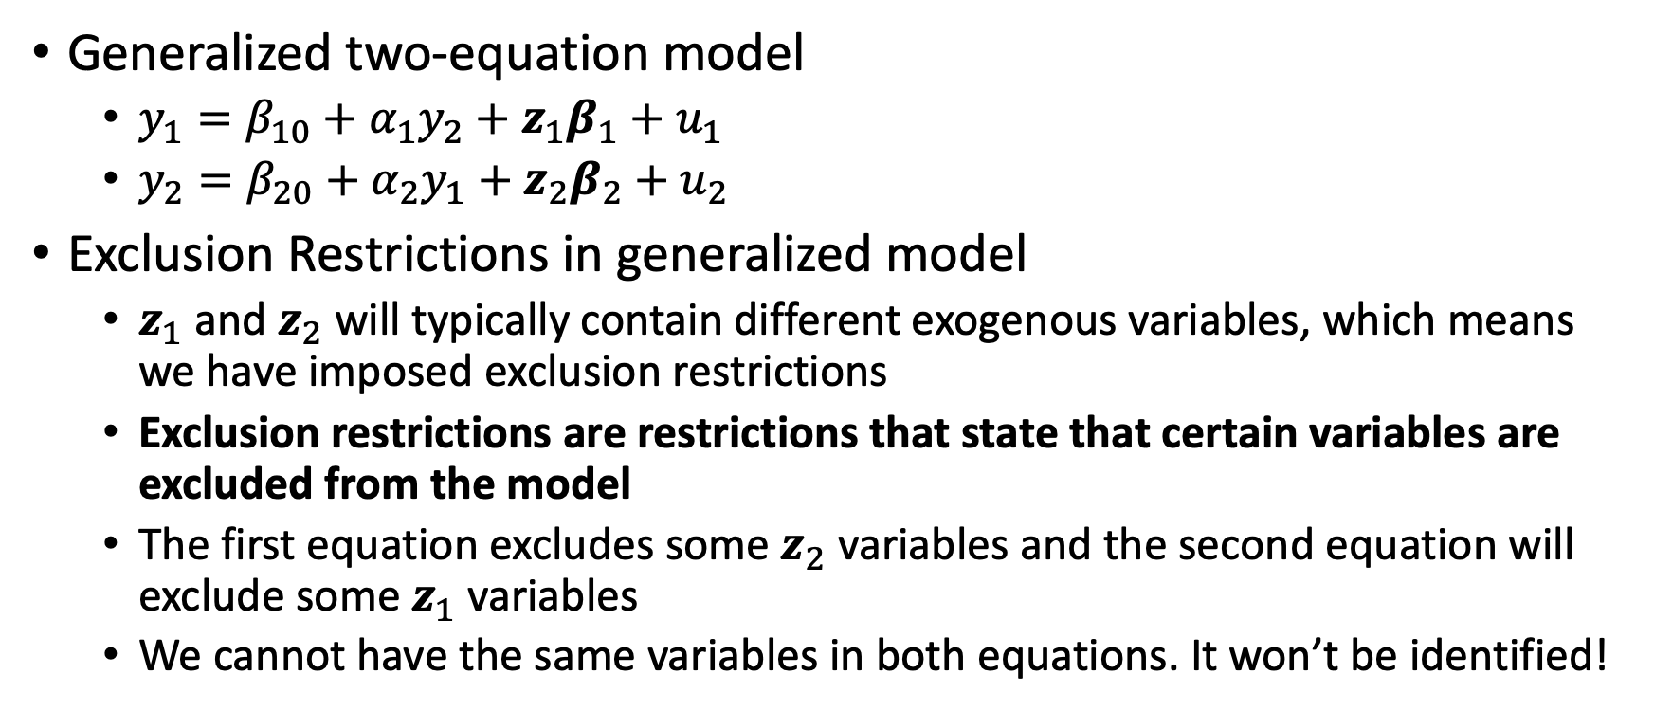
Identifying and Estimating a Structural Equation
Generalized two-equation model
$y_{1}=β_{10}+α_{1}y_{2}+z_{1}β_{1}+u_{1}$
$y_{2}=β_{20}+α_{2}y_{1}+z_{2}β_{2}+u_{2}$
Exclusion Restrictions in generalized model
$z_{1}$ and $z_{2}$ will typically contain different exogenous variables, which means we have imposed exclusion restrictions
Exclusion restrictions are restrictions that state that certain variables are excluded from the model
The first equation excludes some $z_{2}$ variables and the second equation will exclude some $z_{1}$ variables
We cannot have the same variables in both equations. It won’t be identified!

Slide 37
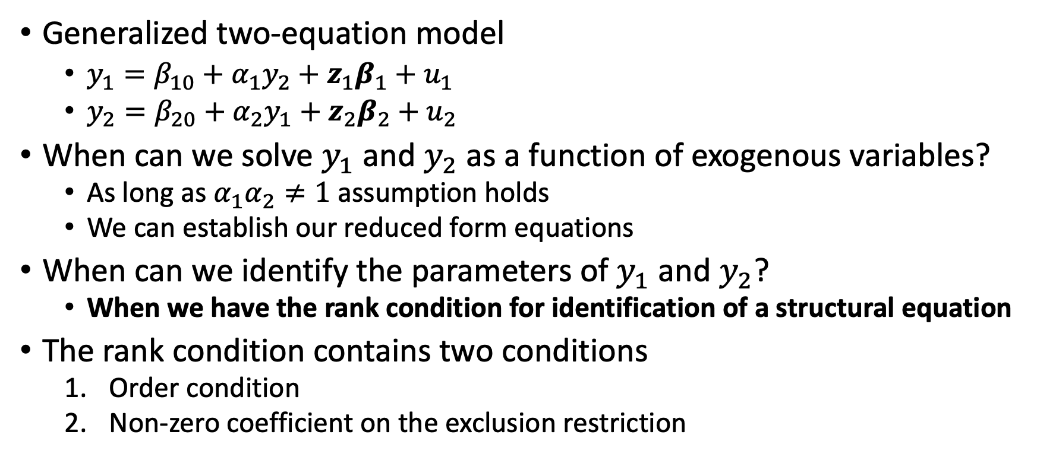
Identifying and Estimating a Structural Equation
Generalized two-equation model
$y_{1}=β_{10}+α_{1}y_{2}+z_{1}β_{1}+u_{1}$
$y_{2}=β_{20}+α_{2}y_{1}+z_{2}β_{2}+u_{2}$
When can we solve $y_{1}$ and $y_{2}$ as a function of exogenous variables?
As long as $α_{1}α_{2}≠1$ assumption holds
We can establish our reduced form equations
When can we identify the parameters of $y_{1}$ and $y_{2}$?
When we have the rank condition for identification of a structural equation
The rank condition contains two conditions
Order condition
Non-zero coefficient on the exclusion restriction

Slide 38
Identifying and Estimating a Structural Equation
Rank condition for identification of a structural equation
The first equation in a two-equation simultaneous equations model is identified if and only if the second equation contains at least one exogenous variables with a non-zero coefficient that is excluded from the first equation
The rank condition has two conditions for identification
Order condition: as many excluded exogenous variables as endogenous variables
Non-zero coefficient on the exclusion restriction
To identify a SEM equation
We need the order condition (necessary but not sufficient)
And, we a non-zero coefficient on the excluded variable in the other equation
Remember
We identify the demand equation because we could see the supply shifter trace out the demand curve

Slide 39
Identifying and Estimating a Structural Equation
The rank condition is the necessary and sufficient condition for us to identify our first equation
As long as the second equation contains an exogenous variable that is excluded from the first equation
The order condition from Week 2 is necessary for the rank condition
The order condition states that at least one exogenous variable is excluded from the equation for our two-equation model
It also states that we have as many excluded exogenous variables as there are included endogenous explanatory variables in the structural equation
The rank condition is similar for the second equation
As long as the first equation contains an exogenous variable excluded from the second equation

Slide 40
Identifying and Estimating a Structural Equation
Once we have identified an equation, we can estimate the parameters of a structural equation
We use a 2SLS estimator
We can look at Stata examples for the estimator
Labor Supply of Married, Working Women
Openness and Inflation

Slide 41
Systems with More Than Two Equations

Slide 42
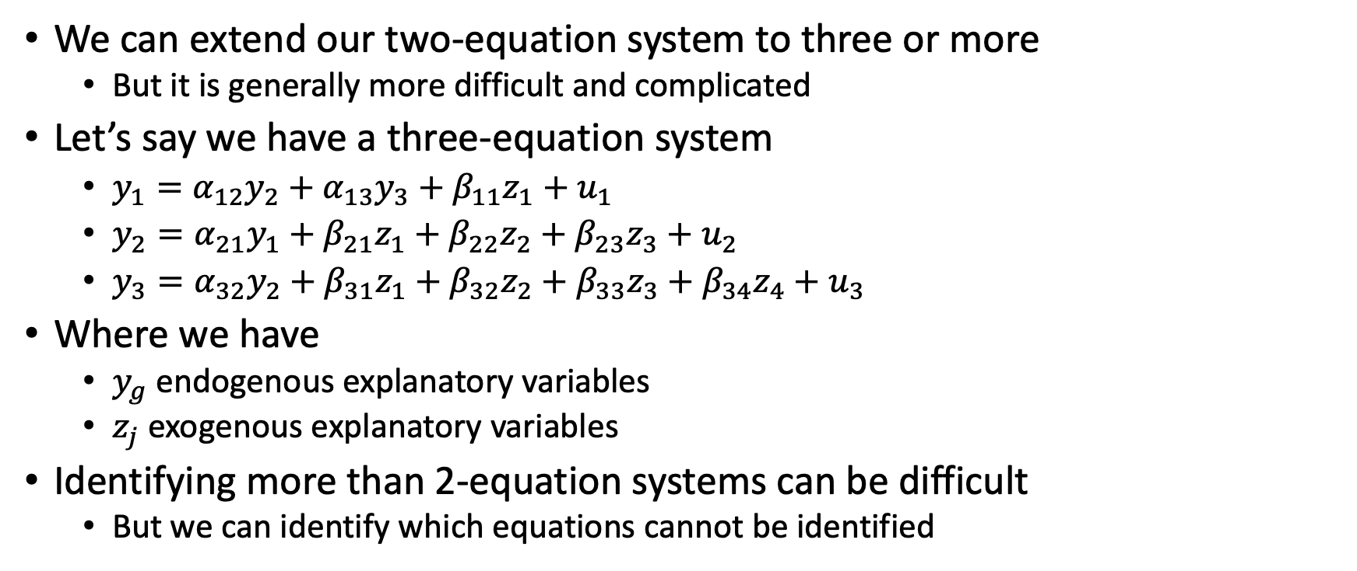
Systems with More Than Two Equations
We can extend our two-equation system to three or more
But it is generally more difficult and complicated
Let’s say we have a three-equation system
$y_{1}=α_{12}y_{2}+α_{13}y_{3}+β_{11}z_{1}+u_{1}$
$y_{2}=α_{21}y_{1}+β_{21}z_{1}+β_{22}z_{2}+β_{23}z_{3}+u_{2}$
$y_{3}=α_{32}y_{2}+β_{31}z_{1}+β_{32}z_{2}+β_{33}z_{3}+β_{34}z_{4}+u_{3}$
Where we have
$y_{g}$ endogenous explanatory variables
$z_{j}$ exogenous explanatory variables
Identifying more than 2-equation systems can be difficult
But we can identify which equations cannot be identified

Slide 43
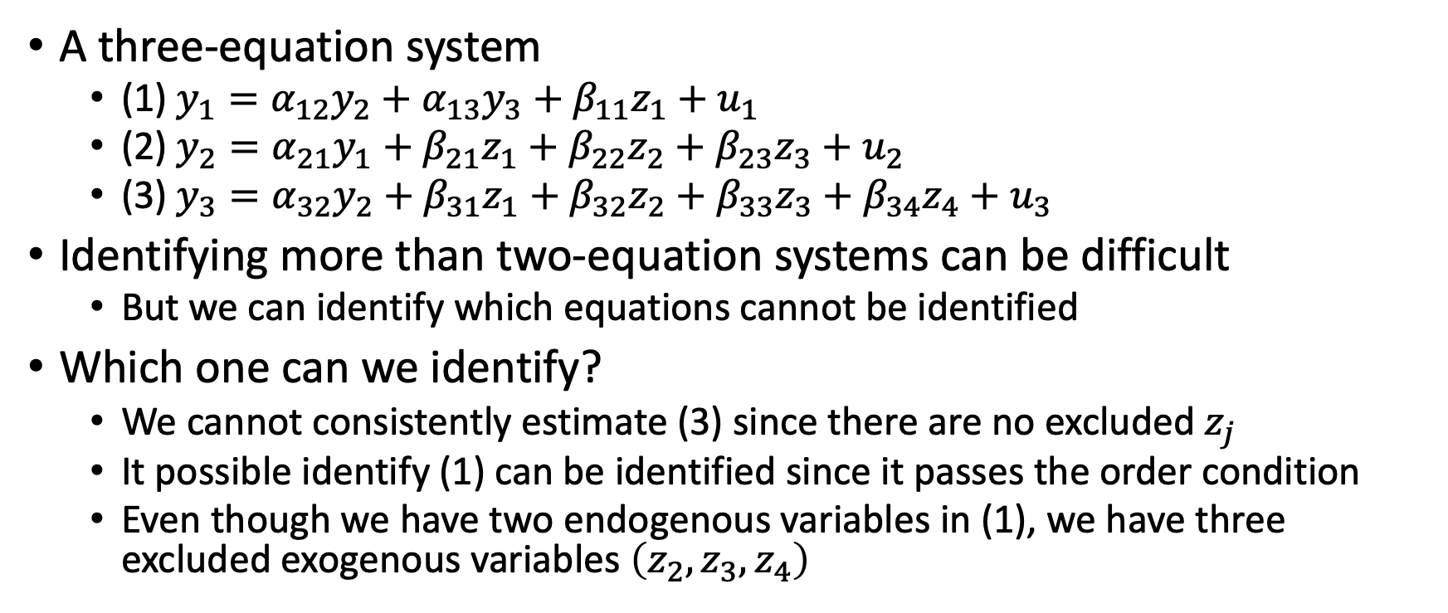
Systems with More Than Two Equations
A three-equation system
(1) $y_{1}=α_{12}y_{2}+α_{13}y_{3}+β_{11}z_{1}+u_{1}$
(2) $y_{2}=α_{21}y_{1}+β_{21}z_{1}+β_{22}z_{2}+β_{23}z_{3}+u_{2}$
(3) $y_{3}=α_{32}y_{2}+β_{31}z_{1}+β_{32}z_{2}+β_{33}z_{3}+β_{34}z_{4}+u_{3}$
Identifying more than two-equation systems can be difficult
But we can identify which equations cannot be identified
Which one can we identify?
We cannot consistently estimate (3) since there are no excluded $z_{j}$
It possible identify (1) can be identified since it passes the order condition
Even though we have two endogenous variables in (1), we have three excluded exogenous variables $\left(z_{2},z_{3},z_{4}\right)$

Slide 44
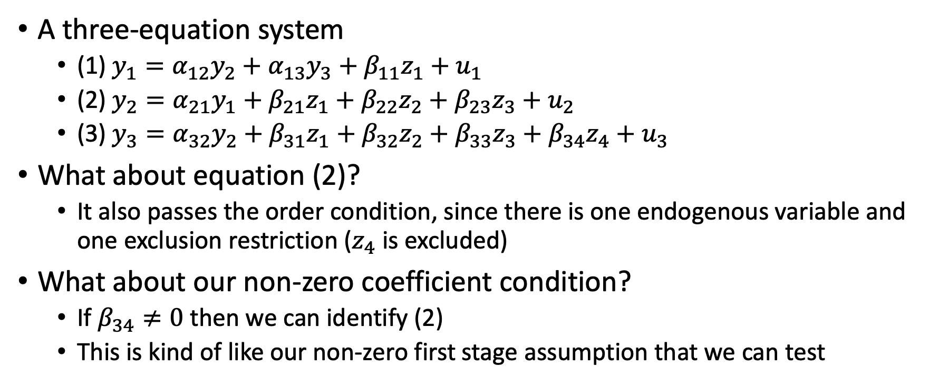
Systems with More Than Two Equations
A three-equation system
(1) $y_{1}=α_{12}y_{2}+α_{13}y_{3}+β_{11}z_{1}+u_{1}$
(2) $y_{2}=α_{21}y_{1}+β_{21}z_{1}+β_{22}z_{2}+β_{23}z_{3}+u_{2}$
(3) $y_{3}=α_{32}y_{2}+β_{31}z_{1}+β_{32}z_{2}+β_{33}z_{3}+β_{34}z_{4}+u_{3}$
What about equation (2)?
It also passes the order condition, since there is one endogenous variable and one exclusion restriction ($z_{4}$ is excluded)
What about our non-zero coefficient condition?
If $β_{34}≠0$ then we can identify (2)
This is kind of like our non-zero first stage assumption that we can test

Slide 45
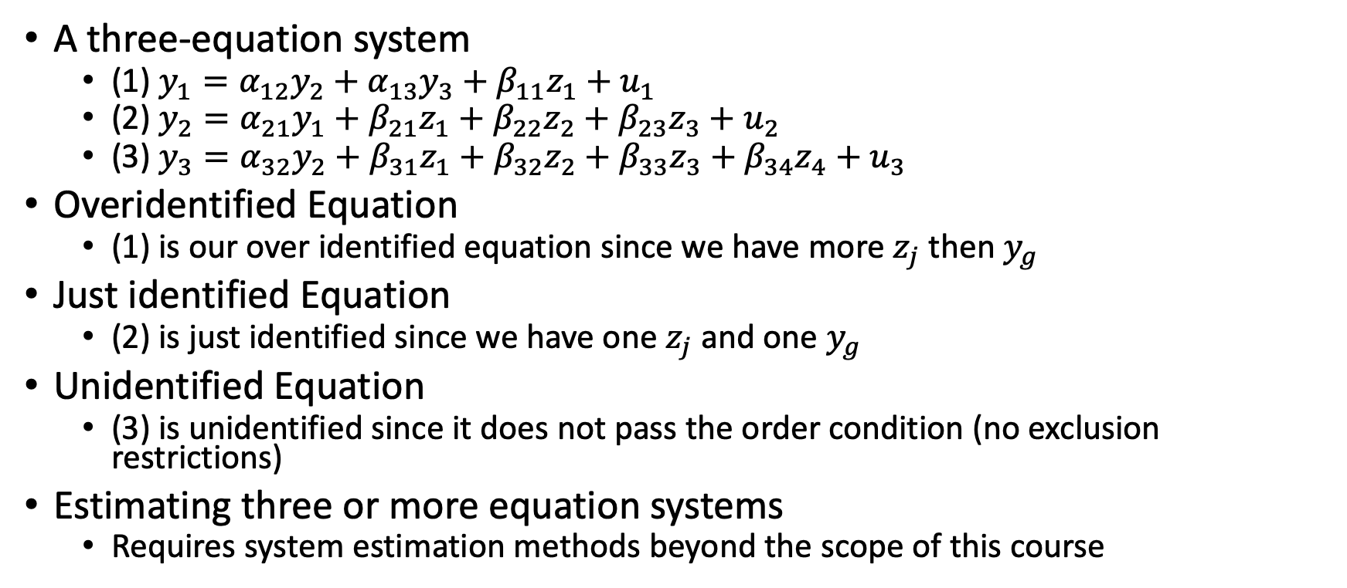
Systems with More Than Two Equations
A three-equation system
(1) $y_{1}=α_{12}y_{2}+α_{13}y_{3}+β_{11}z_{1}+u_{1}$
(2) $y_{2}=α_{21}y_{1}+β_{21}z_{1}+β_{22}z_{2}+β_{23}z_{3}+u_{2}$
(3) $y_{3}=α_{32}y_{2}+β_{31}z_{1}+β_{32}z_{2}+β_{33}z_{3}+β_{34}z_{4}+u_{3}$
Overidentified Equation
(1) is our over identified equation since we have more $z_{j}$ then $y_{g}$
Just identified Equation
(2) is just identified since we have one $z_{j}$ and one $y_{g}$
Unidentified Equation
(3) is unidentified since it does not pass the order condition (no exclusion restrictions)
Estimating three or more equation systems
Requires system estimation methods beyond the scope of this course

Slide 46
Simultaneous Equations Models with Panel Data

Slide 47
SEM with Panel Data
We can have simultaneous equation models occur with panel data
Such as the labor supply of married, working women
When we have SEM with panel data, the general approach is
(1) Eliminate the unobserved time-invariant fixed effect with the within estimator or first-differencing estimator
(2) Find instrumental variables for the endogenous variables in the transformed equation
Key
We need to find an instrument that varies across time
Finding a good instrument is tough enough, but finding a good instrument that varies over time is even harder

Slide 48
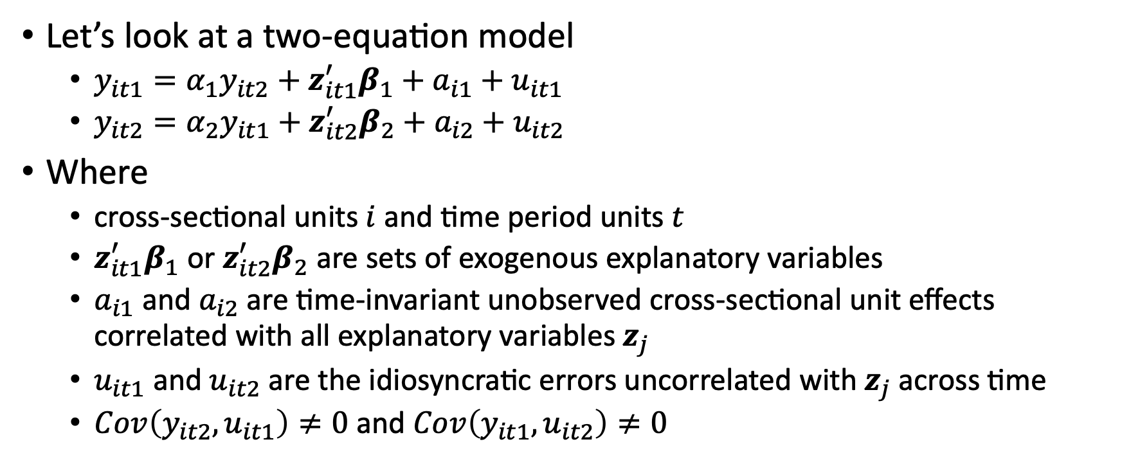
SEM with Panel Data
Let’s look at a two-equation model
$y_{it1}=α_{1}y_{it2}+z_{it1}^{′}β_{1}+a_{i1}+u_{it1}$
$y_{it2}=α_{2}y_{it1}+z_{it2}^{′}β_{2}+a_{i2}+u_{it2}$
Where
cross-sectional units $i$ and time period units $t$
$z_{it1}^{′}β_{1}$ or $z_{it2}^{′}β_{2}$ are sets of exogenous explanatory variables
$a_{i1}$ and $a_{i2}$ are time-invariant unobserved cross-sectional unit effects correlated with all explanatory variables $z_{j}$
$u_{it1}$ and $u_{it2}$ are the idiosyncratic errors uncorrelated with $z_{j}$ across time
$Cov\left(y_{it2},u_{it1}\right)≠0$ and $Cov\left(y_{it1},u_{it2}\right)≠0$

Slide 49
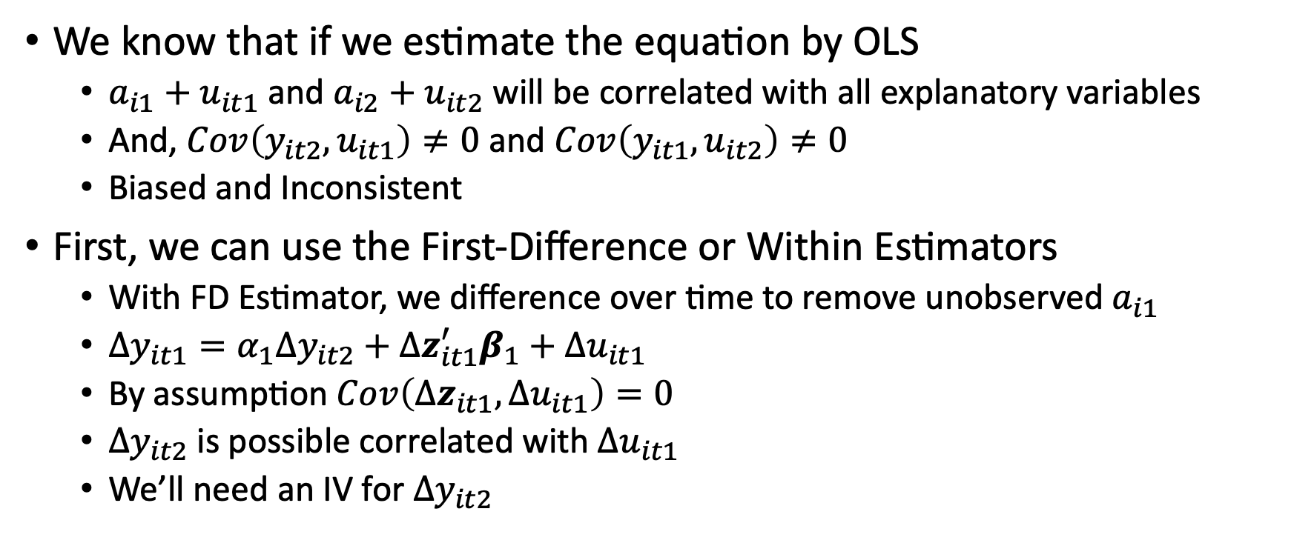
SEM with Panel Data
We know that if we estimate the equation by OLS
$a_{i1}+u_{it1}$ and $a_{i2}+u_{it2}$ will be correlated with all explanatory variables
And, $Cov\left(y_{it2},u_{it1}\right)≠0$ and $Cov\left(y_{it1},u_{it2}\right)≠0$
Biased and Inconsistent
First, we can use the First-Difference or Within Estimators
With FD Estimator, we difference over time to remove unobserved $a_{i1}$
$Δy_{it1}=α_{1}Δy_{it2}+Δz_{it1}^{′}β_{1}+Δu_{it1}$
By assumption $Cov\left(Δz_{it1},Δu_{it1}\right)=0$
$Δy_{it2}$ is possible correlated with $Δu_{it1}$
We’ll need an IV for $Δy_{it2}$

Slide 50
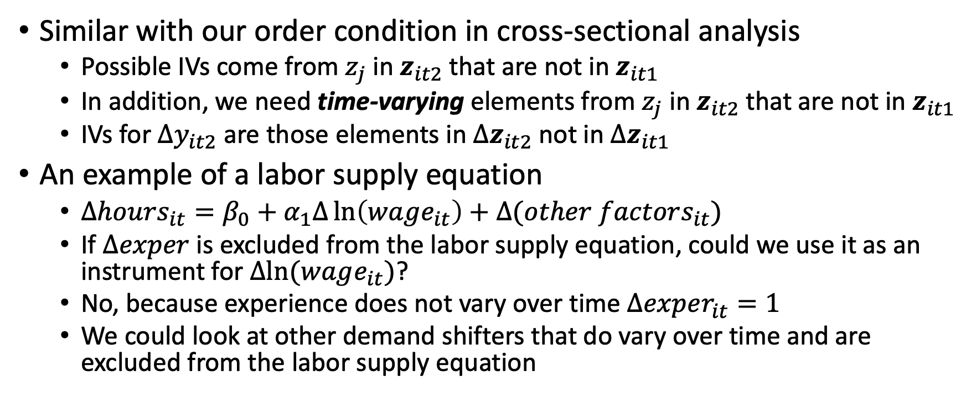
SEM with Panel Data
Similar with our order condition in cross-sectional analysis
Possible IVs come from $z_{j}$ in $z_{it2}$ that are not in $z_{it1}$
In addition, we need time-varying elements from $z_{j}$ in $z_{it2}$ that are not in $z_{it1}$
IVs for $Δy_{it2}$ are those elements in $Δz_{it2}$ not in $Δz_{it1}$
An example of a labor supply equation
$Δhours_{it}=β_{0}+α_{1}Δ\ln\left(wage_{it}\right)+Δ(other factors_{it})$
If $Δexper$ is excluded from the labor supply equation, could we use it as an instrument for $Δln⁡(wage_{it})$?
No, because experience does not vary over time $Δexper_{it}=1$
We could look at other demand shifters that do vary over time and are excluded from the labor supply equation

Slide 51
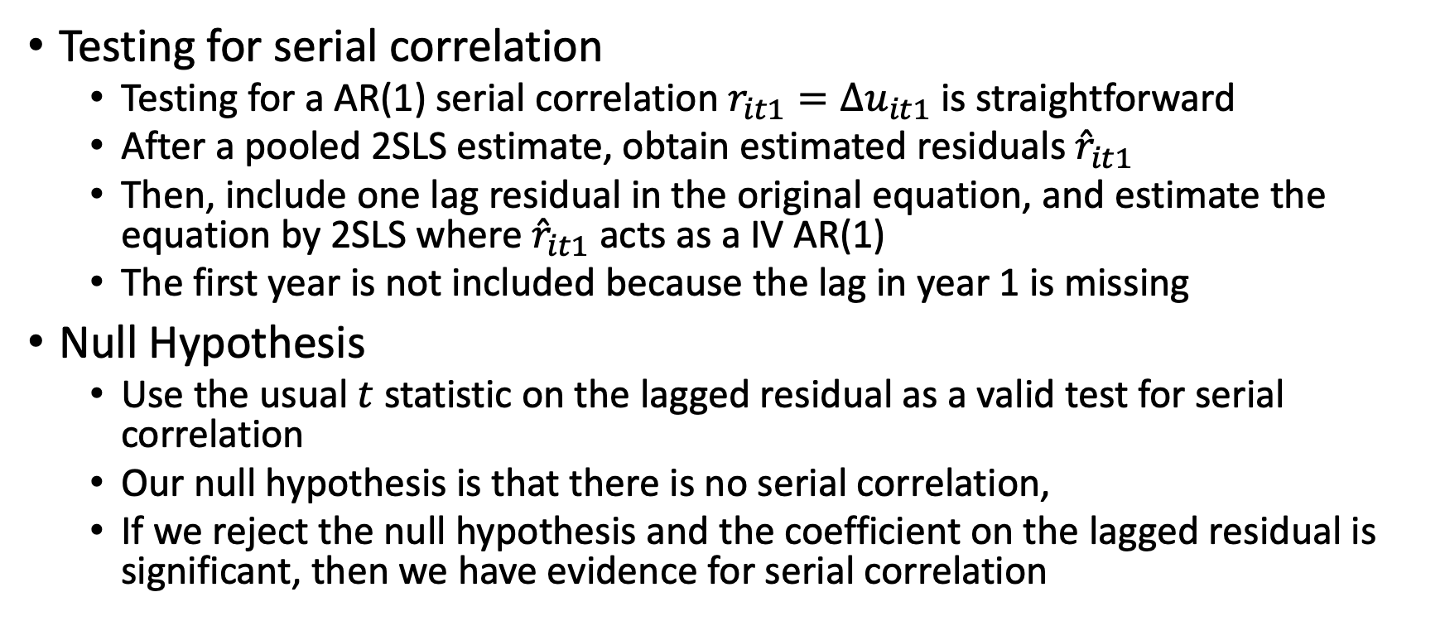
SEM with Panel Data
Testing for serial correlation
Testing for a AR(1) serial correlation $r_{it1}=Δu_{it1}$ is straightforward
After a pooled 2SLS estimate, obtain estimated residuals ${\hat{r}}_{it1}$
Then, include one lag residual in the original equation, and estimate the equation by 2SLS where ${\hat{r}}_{it1}$ acts as a IV AR(1)
The first year is not included because the lag in year 1 is missing
Null Hypothesis
Use the usual $t$ statistic on the lagged residual as a valid test for serial correlation
Our null hypothesis is that there is no serial correlation,
If we reject the null hypothesis and the coefficient on the lagged residual is significant, then we have evidence for serial correlation

Slide 52
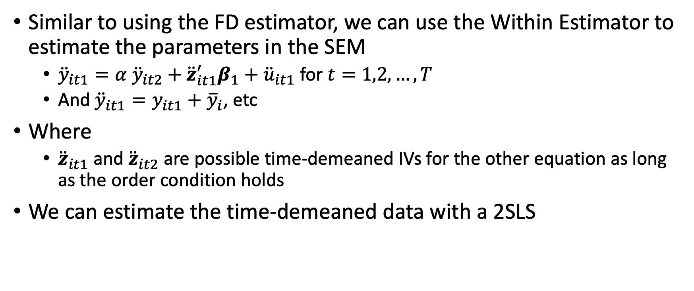
SEM with Panel Data
Similar to using the FD estimator, we can use the Within Estimator to estimate the parameters in the SEM
${\ddot{y}}_{it1}=α {\ddot{y}}_{it2}+{\ddot{z}}_{it1}^{′}β_{1}+{\ddot{u}}_{it1}$ for $t=1,2,…, T$
And ${\ddot{y}}_{it1}=y_{it1}+{\overline{y}}_{i}$, etc
Where
${\ddot{z}}_{it1}$ and ${\ddot{z}}_{it2}$ are possible time-demeaned IVs for the other equation as long as the order condition holds
We can estimate the time-demeaned data with a 2SLS

Slide 53
Stata

